Slide 1
Foreign Direct Investment Analytics
CHANDAN BHATTACHARYA

Slide 2
Problem Statement:
Investment is a game of understanding historic data of investment objects under different events, but it is still a game of chances. To minimize risk, we apply analytics to find the equilibrium in investment.
Specifically, this project aims to understand Foreign Direct Investment (FDI) in India over the last 17 years, from 2000-01 to 2016-17. The dataset contains sector and financial year-wise data of FDI in India. The goals are to:
- Conduct sector-wise investment analysis.
- Perform year-wise investment analysis.
- Identify key metrics and factors.
- Show meaningful relationships between different attributes in the dataset.
- Conduct research to uncover findings that can guide investment decisions and policy-making.

Slide 3
Objective of The Project:
- Understand the Trends:
- Examine yearly trends in FDI to identify periods of significant growth or decline.
- Determine how investments have evolved over time and identify any patterns or anomalies.
- Sector-Wise Analysis:
- Analyze FDI distribution across different sectors to identify which sectors have attracted the most investment.
- Understand the sectoral preferences of foreign investors and highlight key sectors driving FDI.
- Identify Key Metrics:
- Calculate and interpret key metrics such as total investments, yearly growth rates, and sector-wise contributions.
- Identify meaningful relationships between different attributes in the dataset.
- Business Problems and Solutions:
- Address business problems such as diversification of investments across sectors and identification.

Slide 4
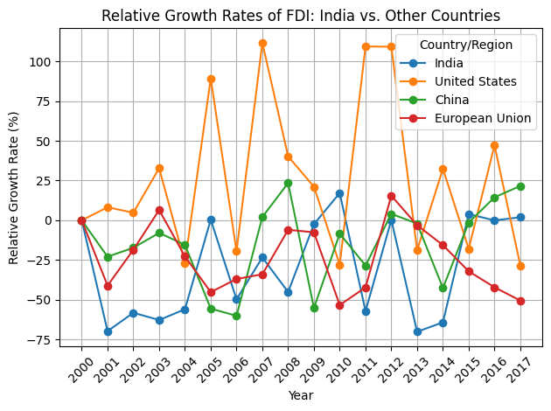
Relative Growth Rates of FDI: India vs Other Countries

Slide 5
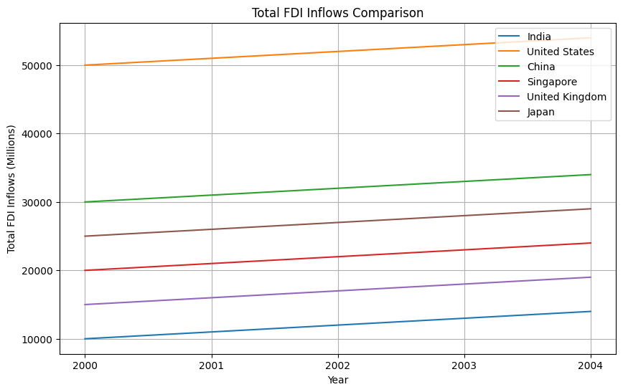
Total FDI Inflows Comparison

Slide 6
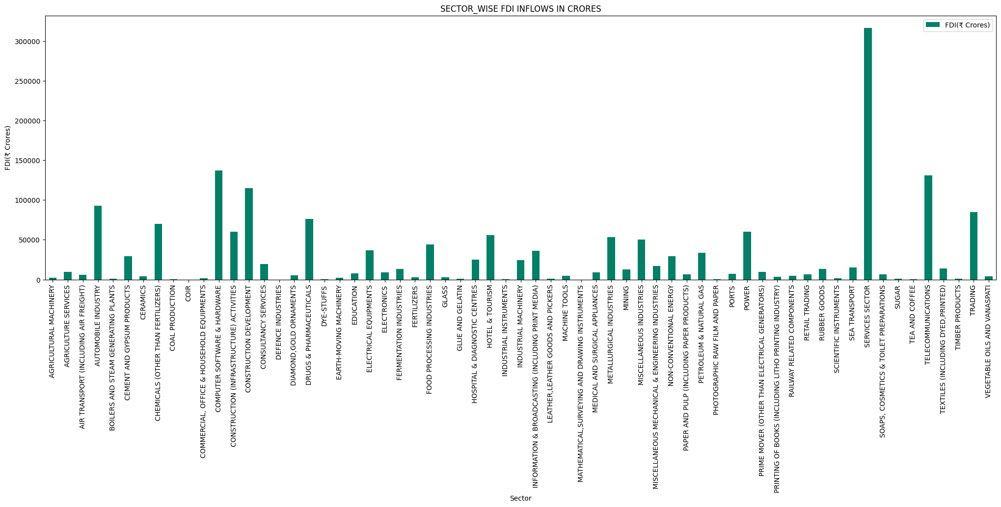
SECTOR-WISE FDI INFLOWS IN CRORES

Slide 7
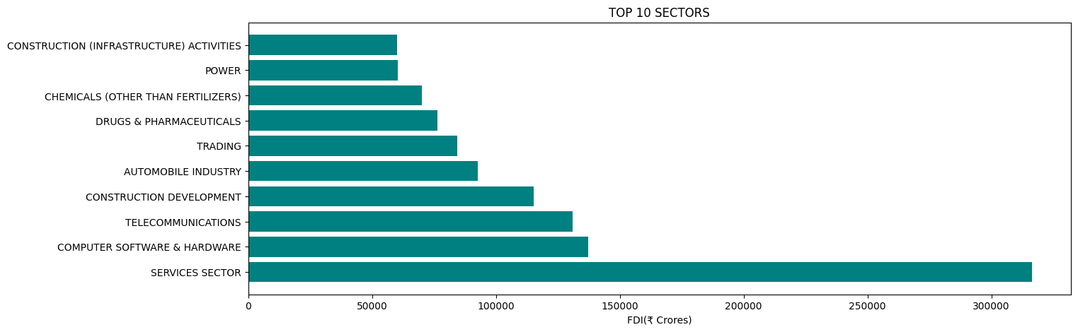
Total FDI Inflow in Top 10 Sectors

Slide 8
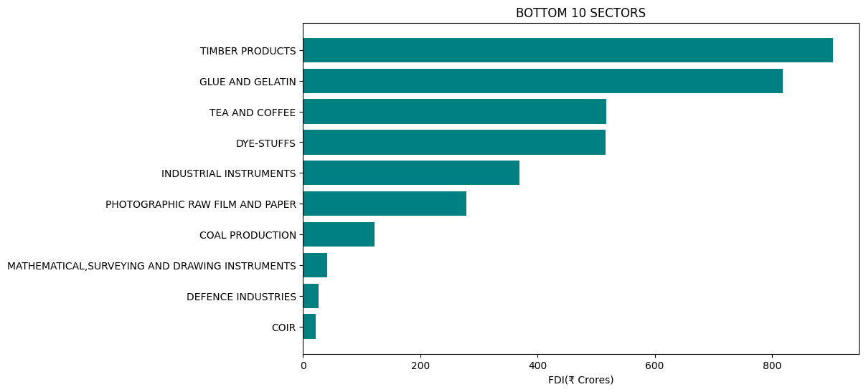
Total FDI Inflow in Bottom 10 Sectors

Slide 9
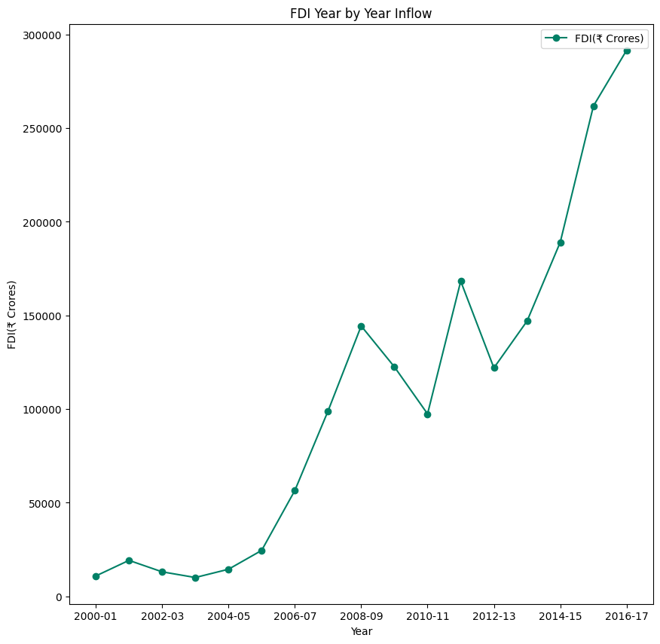
Year by Year FDI Inflow

Slide 10
The Total Amount of FDI Inflows in India During The Last 17 Years ( 2000 to 2017)
The FDI inflow from 2000-2001 i.e. ₹10865.97Cr. in 2001-02 it was ₹19208.02Cr. It shows the Good result in the FDI inflows in India. Little bit ups and downs in FDI inflows up to 2005-06, but after that great hike in the year 2007-08 and FDI was ₹98940.57Cr. In 2008-2009 there was a huge investment in FDI in ₹144390.03Cr. But then there was a downfall in Inflow of FDI in two consecutive years 2009-2010 and 2010-2011, with figures 122558.27 and 97421.29 respectively. We can analysis from the graph that in the year 2011-2012 the inflow of FDI was second highest of last 15 years i.e. 168298.80.Year 2012-13 and 2013-14 the FDI inflow fluctuated from 121984.32 to 147010.90respectively. In last Financial Year i.e.2016-2017 the amount of FDI Inflow were ₹291608.67Cr which is the highest FDI inflow in last 17 years.

Slide 11
Conclusion:
The Sectoral composition of FDI over the period of April 2000 to June 2017, we can find that the largest recipient of such investment is service sector (Financial and non-financial services). The share of this sector in FDI flows is 17 % of the inflow total foreign direct investment. The foreign investors are interested in mainly financial services due its profit generating advantage. This sector gives scope for the foreign investor to takes back the profits to the home country. As service sector the services are consumed in the host country and thereby generating outflow of funds from the host country. There is very low interest towards sectors like Coir, Defence Industries, Mathematical, surveying and drawing Instruments, Coal Production and there are around 28 to 30 sectors where share is less.
Investment Concentration Ratio:
- Analysis reveals fluctuations in FDI investment concentration within the top 5 sectors.
Trend Towards Diversification:
- Recent years show a trend towards decreasing concentration, indicating positive diversification.
- This trend should be encouraged through targeted policies and incentives.
Monitoring and Balanced Growth:
- Monitoring periods of high concentration is essential.
- Ensuring balanced growth across sectors will sustain a robust and diversified economic environment.

Slide 12
Thank You

